Slide 1
Practical Electronics Club
First Real Lab

Slide 2
Why Practical Electronics?
DIY Night Vision

Slide 3
Electronics Basics
Use blackboard or tablet

Slide 4
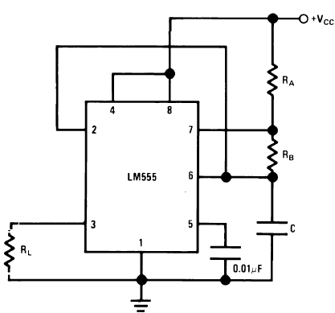


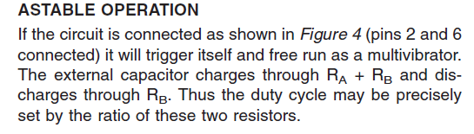
555 Timer

Slide 5
Lazy Method
Online Calculator

Slide 6
What we start out with
We have a 1 uF capacitor
Rate of blinking?
Duty-cycle?

Slide 7
Our Circuit
Ra = Rb = 100k ohm

Slide 8
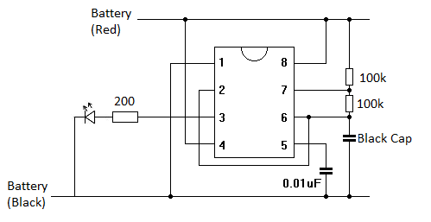
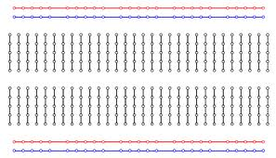
Build Time
Equipment
  Breadboard
  Wire and strippers
  Battery and leads
  2 100k ohm resistors
  0.01 uF cap (green)
  1 uF cap (black)
Notes
  Longer pin is the + side (LED and Capacitors)
  Make sure the notch on the chip is at the top

